Slide 1
AWS Elastic Container Service(ECS)

Slide 2
Problems before Docker?
Problem1 : An Application works in development laptop but not in testing or Production. This is due to difference in computing environment between dev, test or Production.
Problem2: Deploying an Application requires several of Microservices in one machine. So, if you are starting five of those services you require five VMs on that machine.(Wastage of resources, if we run one microservice on one VM).

Slide 3
What are Microservices?
Large application broken down to smaller services, each of these resources together to be turned as Micro-Services.
Micro-Services is divided in to small services and these services are connected via internet to fulfill one particular goal.
Advantages:
Some types of applications become easier to build & maintain when they are broken in to smaller, Composable pieces which work together.
If we want to update any module in application, it becomes easier because the dependencies will be less.

Slide 4
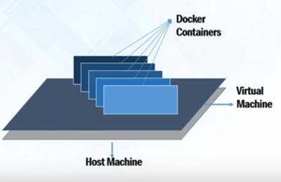
Solutions after Docker
For Problem1, the containers have same computing environment across the Life cycle i.e., Dev, Test and Prod.
For Problem2, You can run microservices in the same VM by running various Docker Containers for each Service.(As I said in beginning Docker Containers are light weight containers that don’t need preallocation of memory and storage)

Slide 5
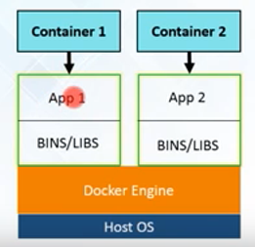
What is Docker?
Docker is a tool designed to make it easier to create, deploy and run application by using containers.
Docker Containers are light-weight alternatives to Virtual Machines(VMs) and it uses the host operating system.
For Docker Containers, We don’t need to Pre-allocate any RAM as we do in VMs.
Containers takes how much the application require or a Microservice require.

Slide 6
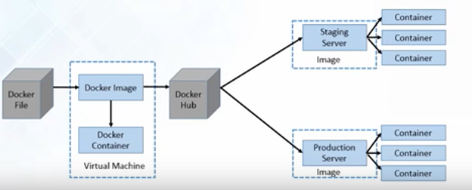
Contd..
Docker File(Contains Project Code and dependencies) builds a Docker image and that image.
You can run that image to create as many Docker Containers as you want.
Then, this image can be uploaded on Docker hub, From Docker hub any one can pull the image and build a container.

Slide 7
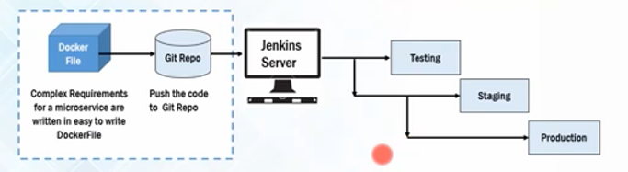
Contd..
Create Complex requirements for a Microservice with in an easy to write Docker file.
Push the code to Git Repo and Continuous Integration(CI) server pull it down and build the exact environment that will be used in production.

Slide 8
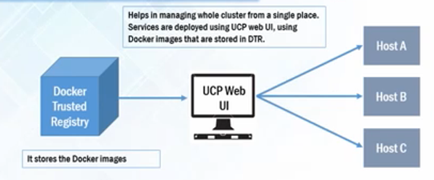
Docker Data Center(DDC)
Universal Control Pane(UCP) helps in managing whole cluster from a single place, Services are deployed using UCP web UI, using Docker images that are stored in Data Trusted Registry.(DTR)

Slide 9
Docker Registry:
It is a Storage component for Docker images
Docker hub is a Docker’s very own Cloud Repository
Docker Images:
Read-only template used to create containers
Stored in Docker hub or your local Registry
Docker Containers:
Isolated Application platform
Contains everything needed to run the Application.

Slide 10
What is ECS?
Amazon Elastic Container Service (Amazon ECS) is a highly scalable, fast, container management service that makes it easy to run, stop, and manage Docker containers on a cluster.
You can host your cluster on a serverless infrastructure that is managed by Amazon ECS by launching your services or tasks using the Fargate launch type or EC2 Launch type

Slide 11
ECS Launch Types:
Fargate Launch type:
The Fargate launch type allows you to run your containerized applications without the need to provision and manage the backend infrastructure. Just register your task definition and Fargate launches the container for you.
EC2 Launch Type:
The EC2 launch type allows you to run your containerized applications on a cluster of Amazon EC2 instances that you manage.

Slide 12
Features of Amazon ECS:
Amazon ECS is a regional service that simplifies running application containers in a highly available manner across multiple AZ’s in region.
Once the Cluster is UP, you can define task definitions and services that specify with Docker Container images to run across your Clusters.

Slide 13
Task Definitions:
To Prepare your application to run on Amazon ECS, You create a task definition.
Task Definition is a text file in JSON format, that describes one or more Containers.
Task Definitions specify various parameters for your applications.
Examples of task definition parameters are which containers to use and the repositories in which they are located, which ports should be opened on the container instance for your application, and what data volumes should be used with the containers in the task.

Slide 14
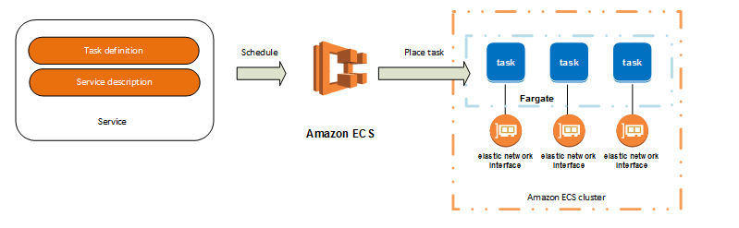
Tasks and Scheduling
A task is the instantiation of a task definition within a cluster. After you have created a task definition for your application within Amazon ECS, you can specify the number of tasks that will run on your cluster.
The Amazon ECS task scheduler is responsible for placing tasks within your cluster. There are several different scheduling options available. For example, you can define a service that runs and maintains a specified number of tasks simultaneously.

Slide 15
Clusters:
When you run tasks using Amazon ECS, you place them on a cluster, which is a logical grouping of resources.
If you use the Fargate launch type with tasks within your cluster, Amazon ECS manages your cluster resources.
If you use the EC2 launch type, then your clusters will be a group of container instances you manage. Amazon ECS downloads your container images from a registry that you specify, and runs those images within your cluster.

Slide 16
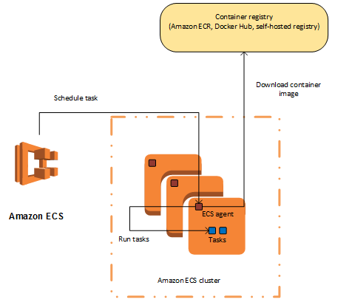
Container Agent
The container agent runs on each infrastructure resource within an Amazon ECS cluster. It sends information about the resource's current running tasks and resource utilization to Amazon ECS, and starts and stops tasks whenever it receives a request from Amazon ECS

Slide 17
SERVICES:
Amazon ECS allows you to run and maintain a specified number (the "desired count") of instances of a task definition simultaneously in an Amazon ECS cluster. This is called a service.
If any of your tasks should fail or stop for any reason, the Amazon ECS service scheduler launches another instance of your task definition to replace it and maintain the desired count of tasks in the service.
In addition to maintaining the desired count of tasks in your service, you can optionally run your service behind a load balancer.

Slide 18
Creating Docker Image and Pushing image to ECS

Slide 19
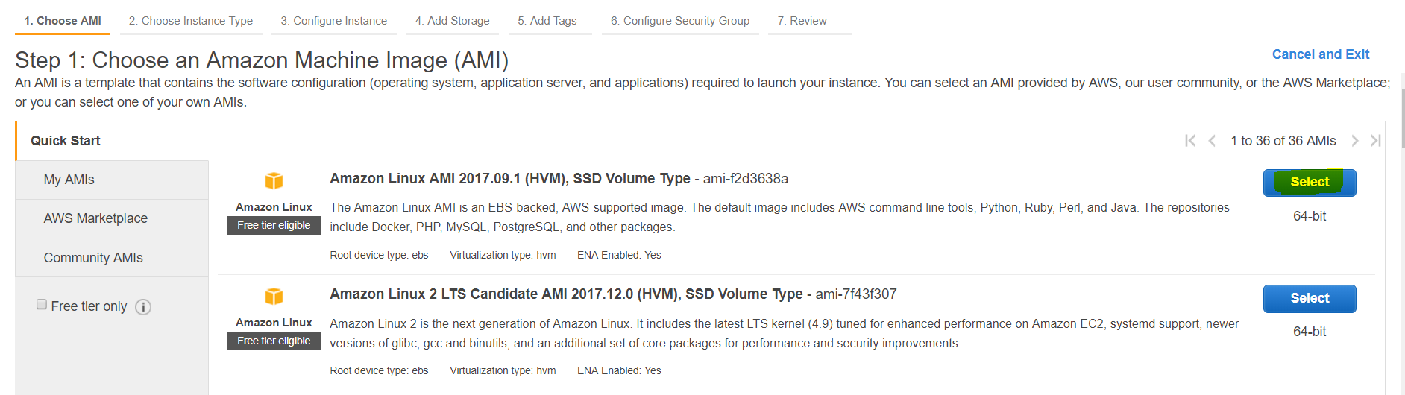
Sign into EC2 console and click on Launch instance and select Amazon AMI.

Slide 20
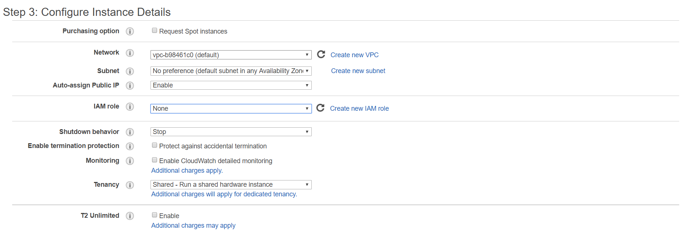
Select the t2.micro and Select the existing VPC(If you have one) or keep default VPC.
Here, I am going with default VPC.

Slide 21
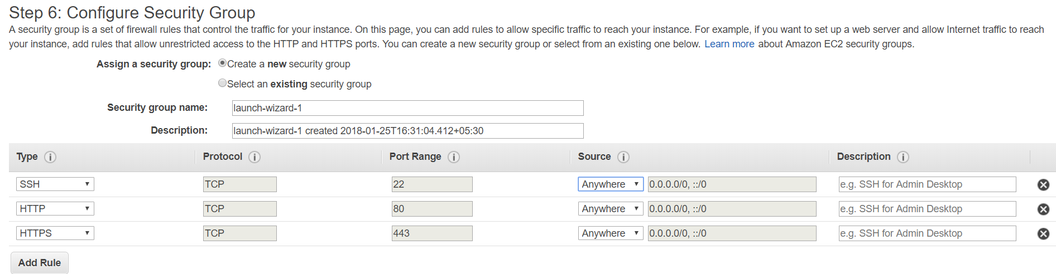
Container Agent is Pre-installed on Amazon Linux AMI. So, no need to add it as Bootstrap script or install it.
Create the Security group and Open the 80 port.

Slide 22
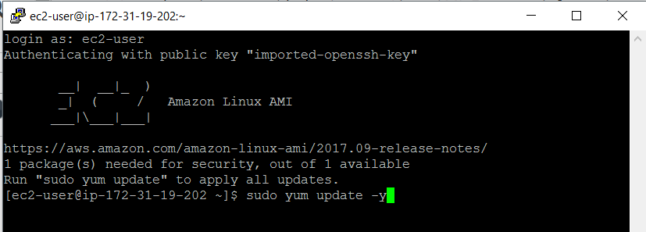
Once the Instance got launched, Login to instance.
Once you logged in, Update the installed packages and package cache on your instance.
Give the command as Sudo yum update -y

Slide 23
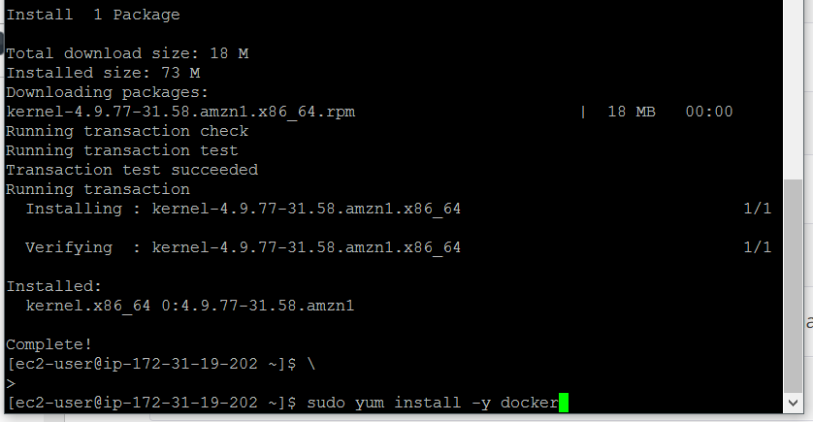
Once the Updates complete, Install Docker .
For installing Docker, command is Sudo yum install –y docker

Slide 24
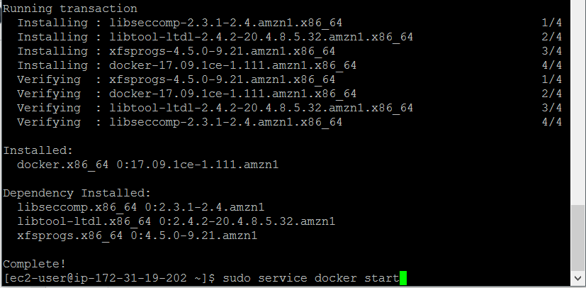
Next, Start the Docker Service.

Slide 25
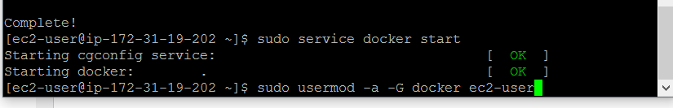
Add the ec2-user to the docker group so, you can execute Docker commands without using sudo.

Slide 26
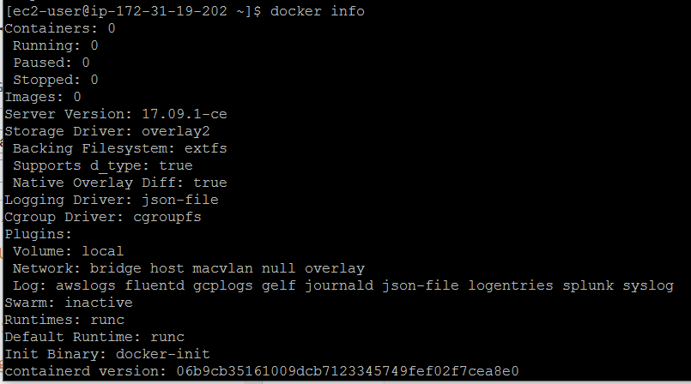
Logout and Login back to pick up the new group permissions.
Verify that the ec2-user can run the docker command without using sudo.
Give command as docker info.

Slide 27
Now Create Docker Image.
Create a file called called Docker file.
A Dockerfile is a manifest that describes the base image to use for your Docker image and what you want installed and running on it.
Give the Command as touch dockerfile

Slide 28
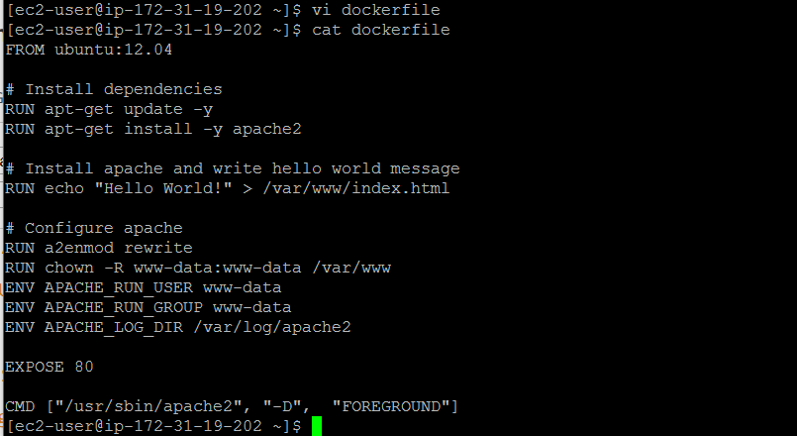
Edit the file and add the below content.
This docker file uses the Ubuntu 12.4 image and instructions update the package caches, install some software packages for the web server, and then write the "Hello World!" content to the web server's document root.

Slide 29
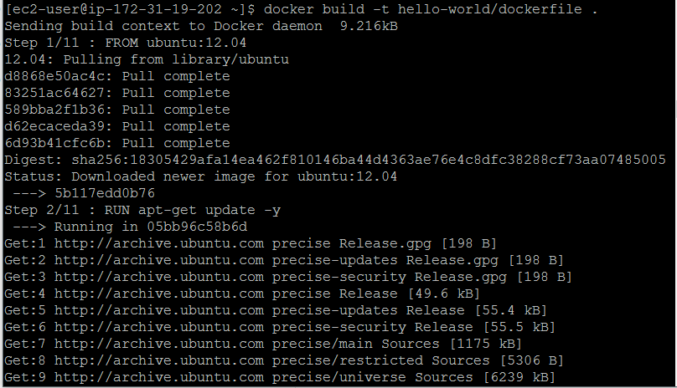
Build the Docker image from your Dockerfile.
Give the command as docker build –t hello-world/dockerfile

Slide 30
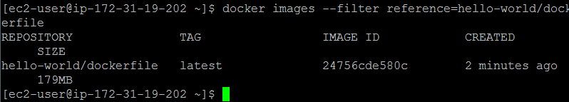
Run docker images to verify the image was created successfully or not.
Give the command as docker images –filter reference=hello-world/dockerfile
Output:

Slide 31

Run the newly built image. The –p 80:80 option maps the exposed port 80 on the container to port 80 on the host system.
Output from the Apache web server is displayed in the terminal window. You can ignore the “Could not reliably determine the server’s fully qualified domain name” message.
Now, Click on your public IP of the Instance and you can view the hello world web page in browser

Slide 32
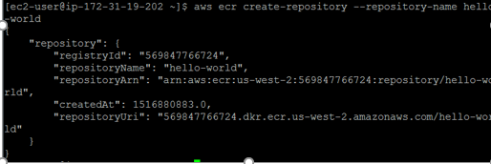
Push your image to Amazon Elastic Container Registry
Amazon ECR is a managed AWS Docker registry service.
Create an Amazon ECR Repository to store your hello-world image. Note the Repository URL from output.
Command is aws ecr create-repository –repository-name hello-world.

Slide 33

Tag the hello-world image with the Repository URL value with the previous step.
Command is docker tag hello-world/dockerfile aws-account-id.dkr.ecr.us-west-2.amazonaws.com/hello-world

Slide 34
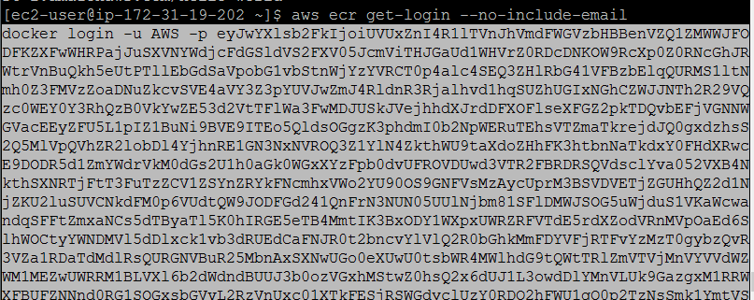
Run the aws ecr get-login –no-include-email to get the docker login authentication string for your registry
Run the docker login command that was returned in the previous step. This command provides an authorization token that is valid for 12 hours.

Slide 35

Once you run the command , you will see the output as below.

Slide 36
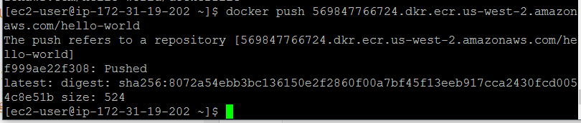
Push the image to Amazon ECR with the Repository URL value from the earlier step.

Slide 37
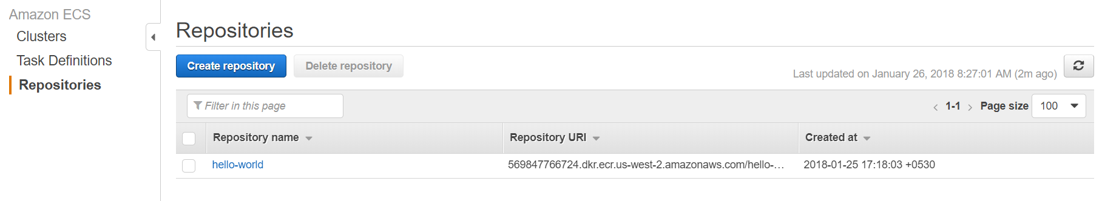
Once you login to ECS Console, You will see the repository created with the name hello-world.

Slide 38
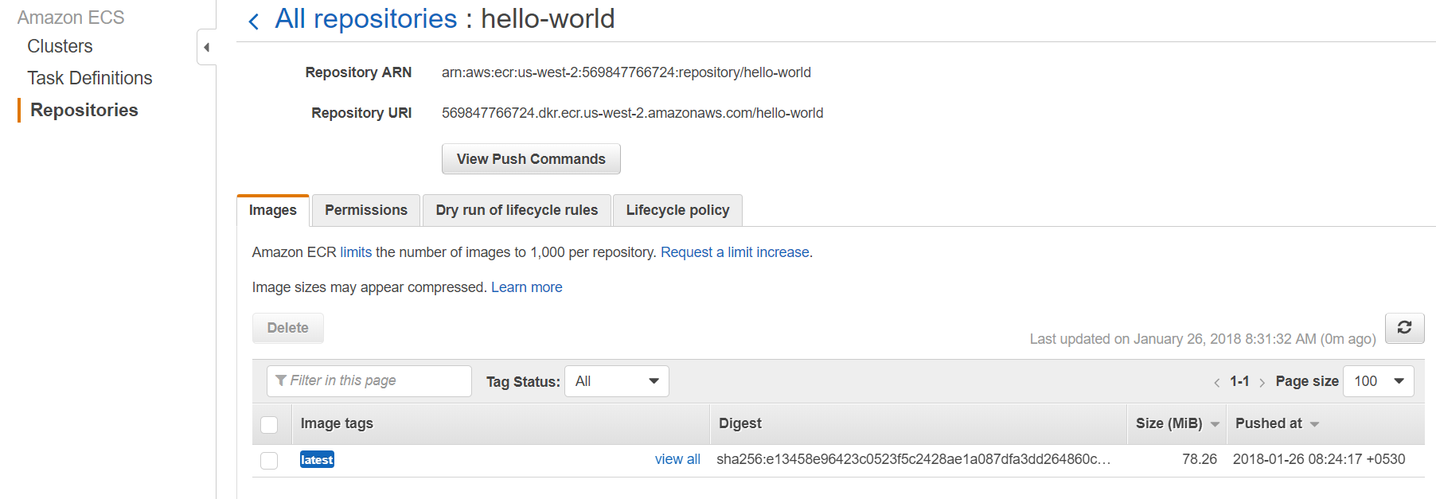
Click on the hello-World and you will see the pushed image in the Repository.

Slide 39
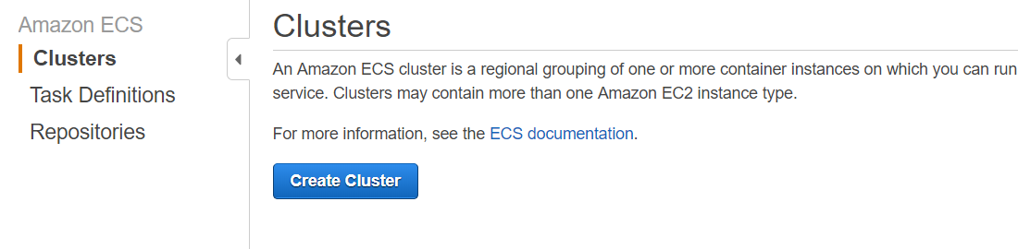
Click on the Clusters tab and Click on Create Cluster.

Slide 40
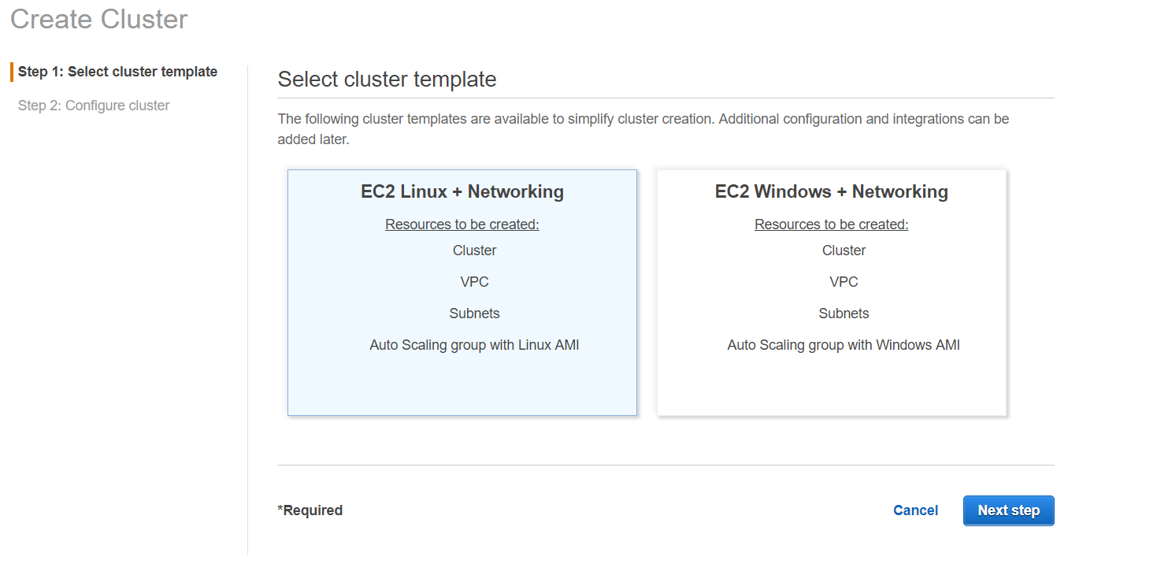
In Next page, Select the Cluster template as EC2 Linux + Networking.
Click on Next Step.

Slide 41
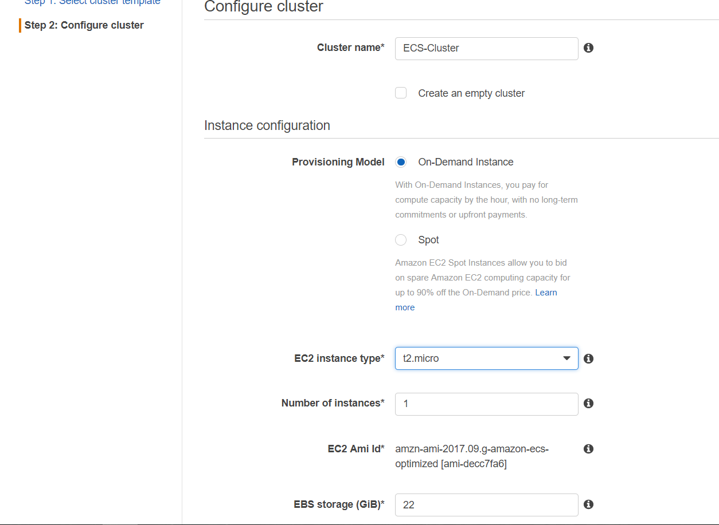
Give the Cluster Name and select Instance type as t2.micro.

Slide 42
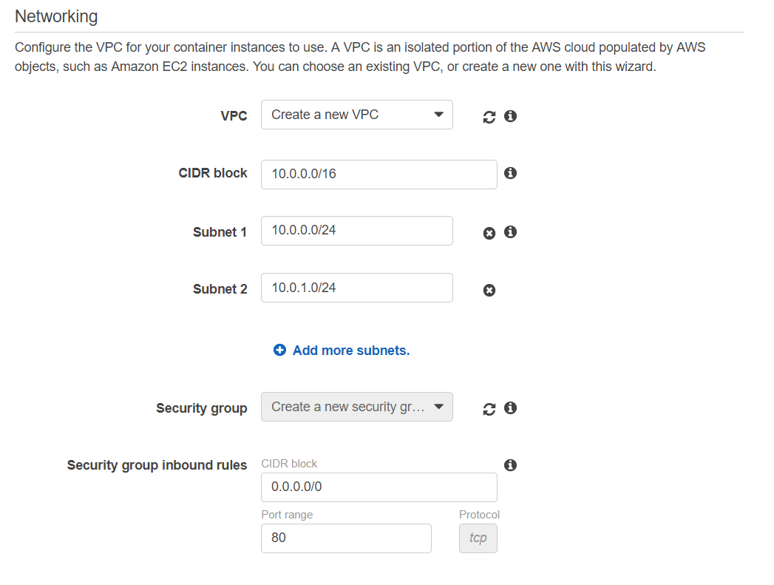
Here, You can create new VPC or can give the Existing one.
Specify the Security group if you have one for container or if not it will create one for you.

Slide 43
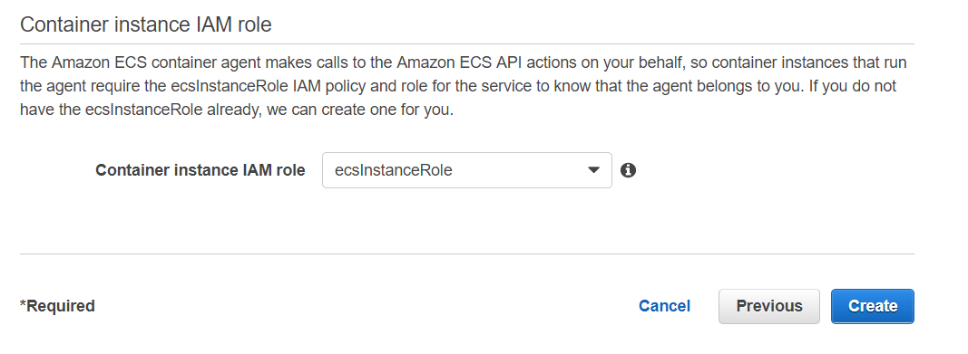
Give the Instance Role that gives Amazon EC2 container service role for EC2.
Here, ECS will create a role, if we not specify anything.
Click on Create

Slide 44
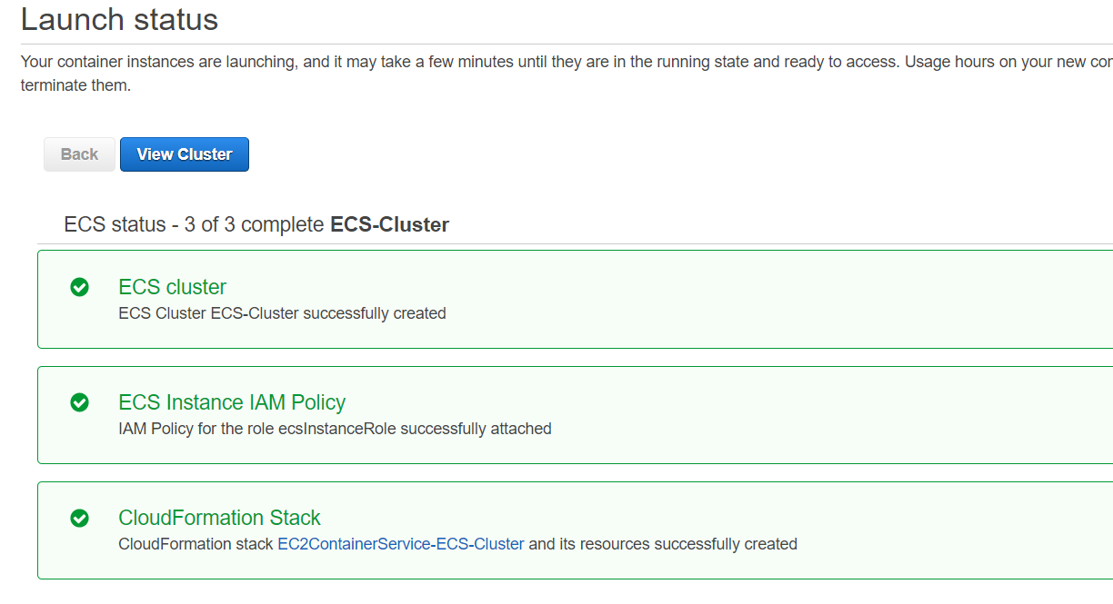
Once you click on Create, You can see a page like below.

Slide 45
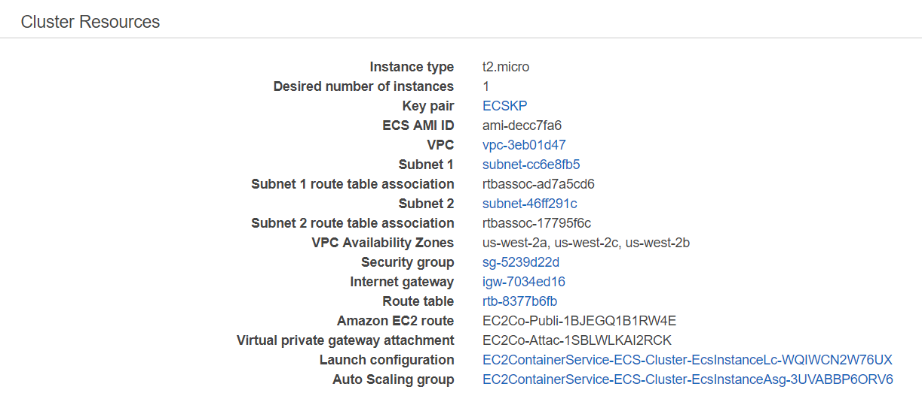
When you scroll down the Clusters page, You will see the below resources got created successfully.

Slide 46
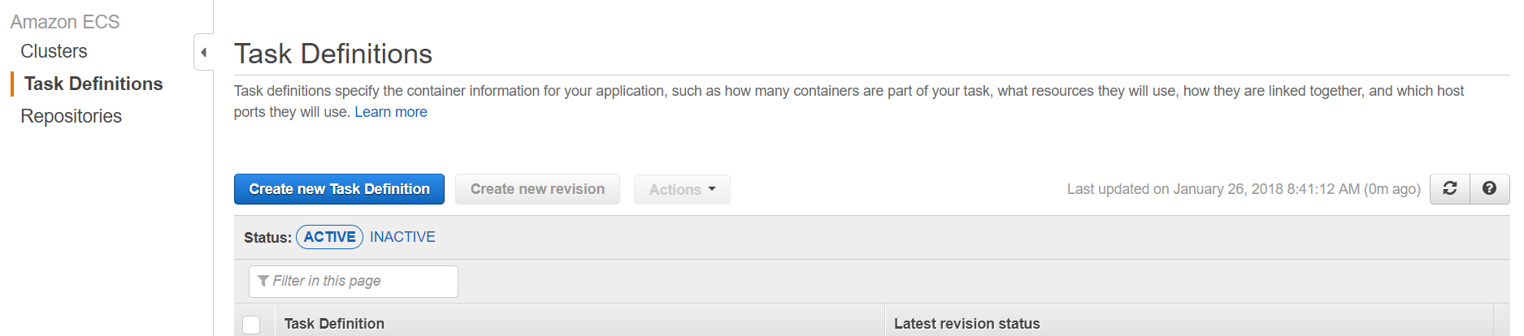
Once the Cluster is Active, Click on Task Definition tab.
In Task definition tab, Click on Create new task definintion.

Slide 47
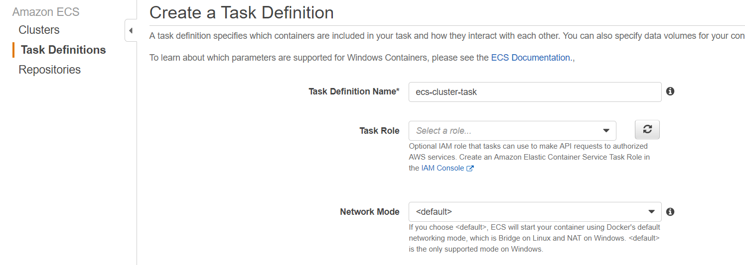
Give the task definition name and Leave the other values as default for this demo.

Slide 48
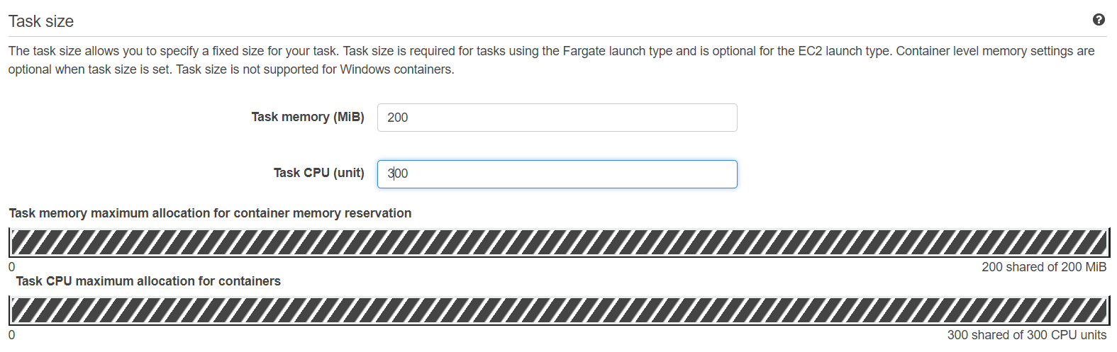
Select the task size that your container require.

Slide 49
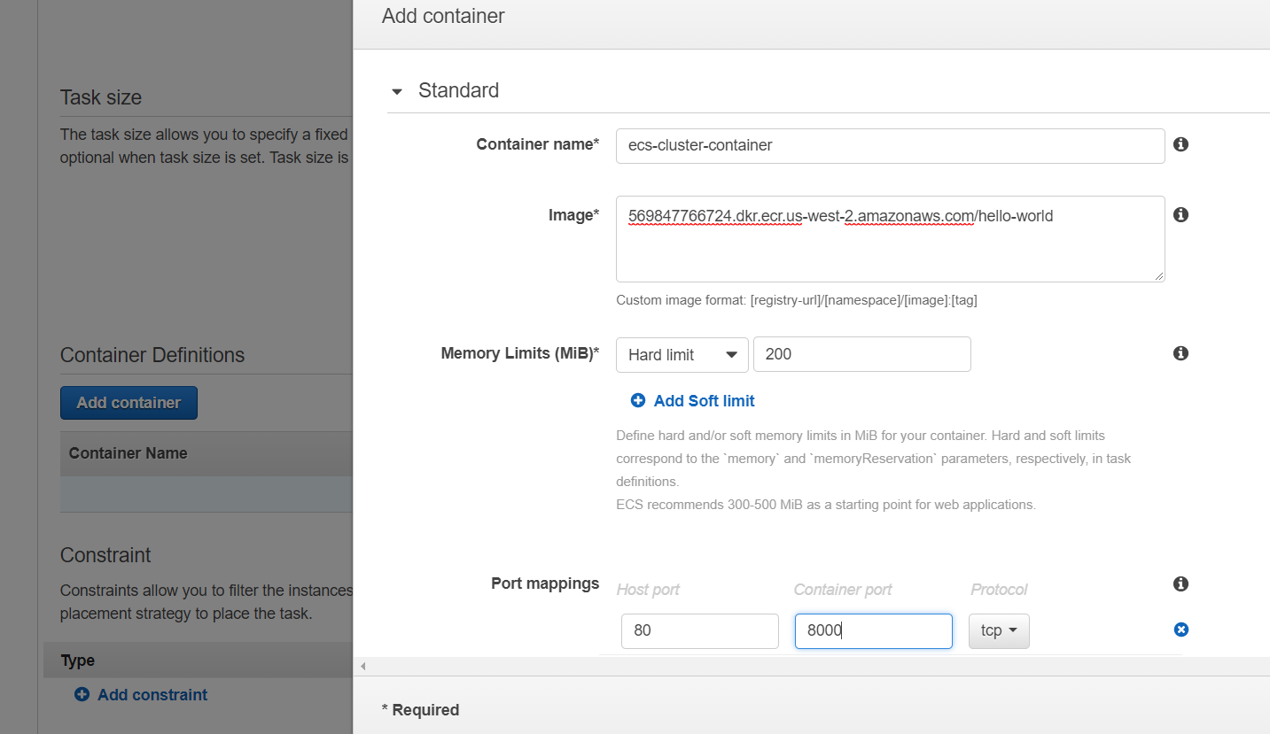
Click on Add Container and give the Name , Repository URL in which the image reside and the Hard Limit.
Give the Port Mappings for the Host and the Container and leave the other values as default and click on Add.

Slide 50
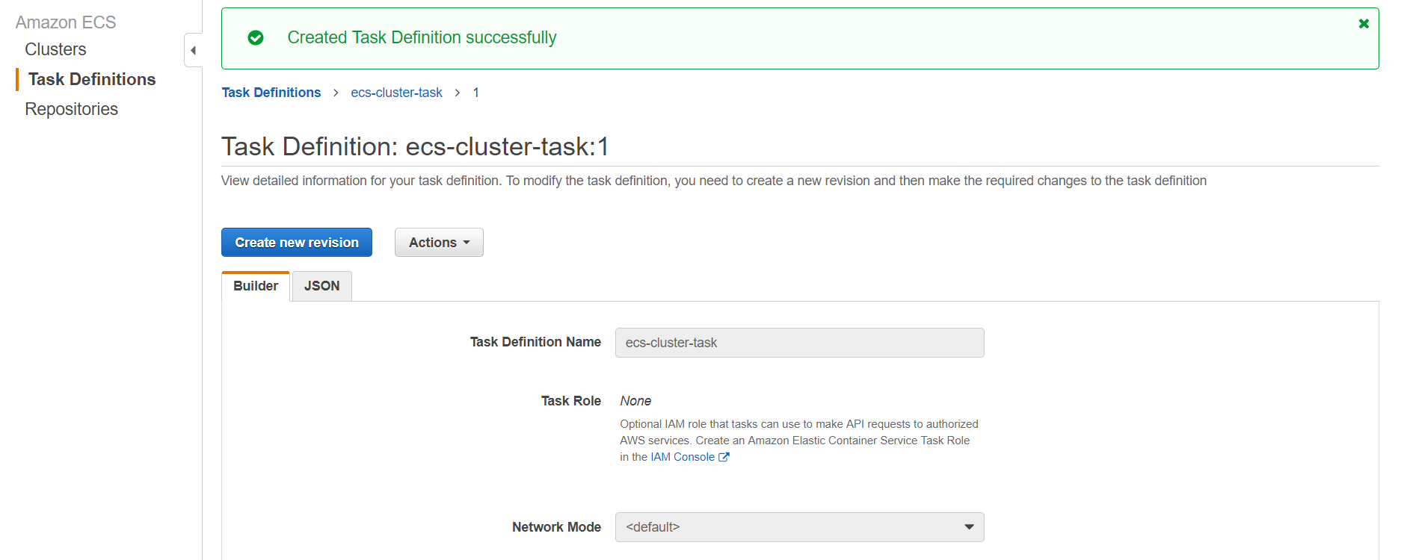
Once the task got created successfully, you can the page like below.

Slide 51
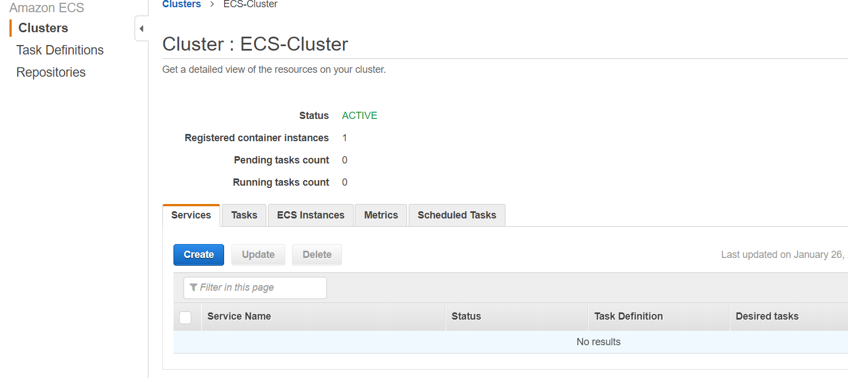
Now, Click on the Cluster tab and click on Services button.
Click on Create

Slide 52
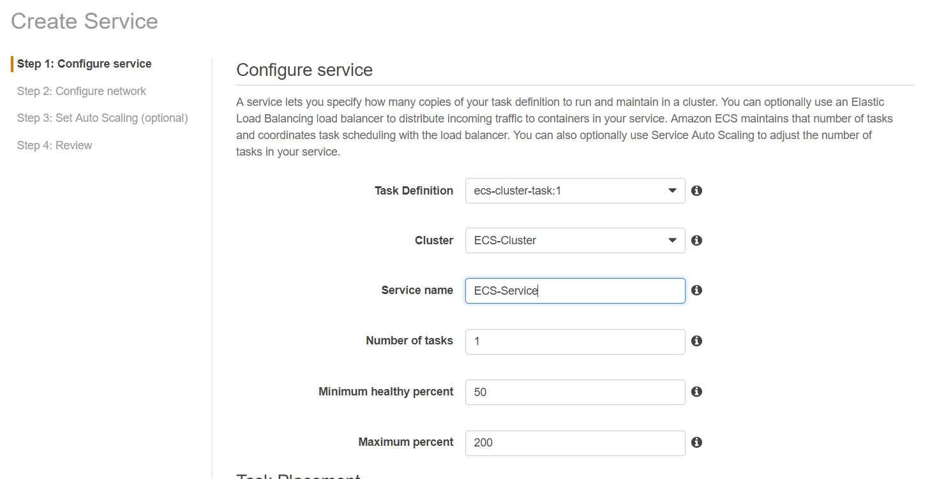
In Configure Service tab, Give the Service name and desired count of the tasks.

Slide 53
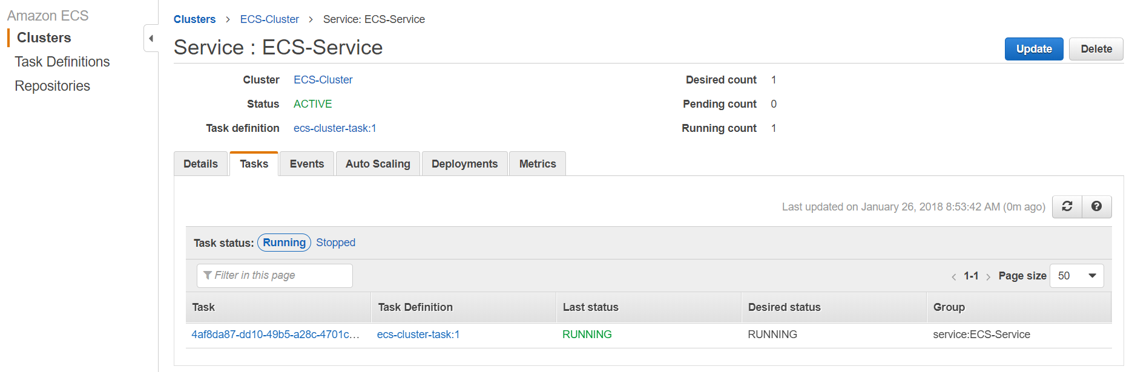
Under Tasks tab, You can see the Instances running in that task.

Slide 54
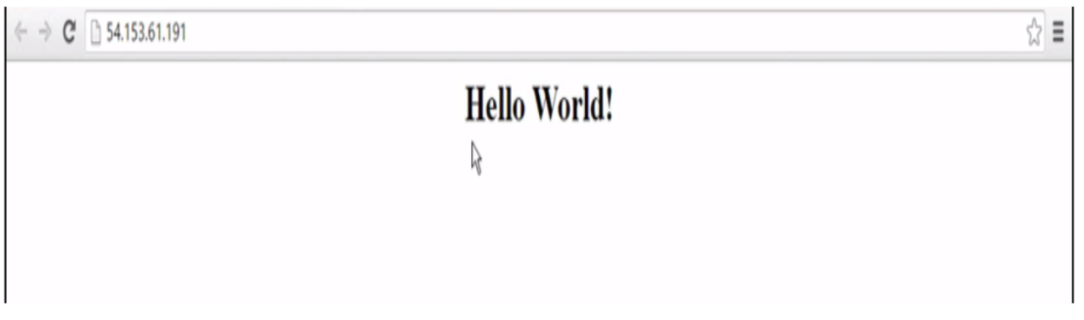
Now, Take the Public IP of the ECS instance and put it in browser.
It displays the simple Hello World web page.

Slide 55
THANK YOU

